Slide 2
BIOLOGICAL TREATMENT SOLUTIONS -ROOTS
ROOTS speciality & advantages
The special characteristics of ROOTS compared to many conventional system available in the market are:-
Complete biological process. Thus no chemical that causes harm to environment is present
Decomposition of fat, Oil and grease is very high. Hence, subsequent processes to reduce BOD, COD, ammoniacal nitrogen, total nitrogen and other pollutants can easily be achieved
Energy consumption is very low due to low energy air diffusers
Very low operational maintenance cost. Usually less than 10 ppm of enzyme is required for most application
Immediate reaction of enzyme using activation system. Shorter process stabilization duration
Accepts very high BOD loading. More than 1 kg/m3 can be treated easily.
pH ranging from 4 to 11 can be accommodated by ROOTS
Drastically reduces Odou
BLUE E TECH SDN.BHD

Slide 3
ROOTS PROJECT TRACK RECORD
ROOTS has been widely installed in Japan. A list of the track record is shown herein
BLUE E TECH SDN.BHD

Slide 4


ROOTS PATENT
ROOTS original process has been patented in Japan by our principal JESC
SB-1 Liquid Preparation
Patented
in Japan
Dehydrator
Dewatered Cake
Effluent
Raw Wastewater
FOG Decomposition Tank
（Previous Equalization Tank）
DAF
Contact Aeration Tank
（Previous Aerobic Sludge Tank）
Settling tank
BLUE E TECH SDN.BHD

Slide 5
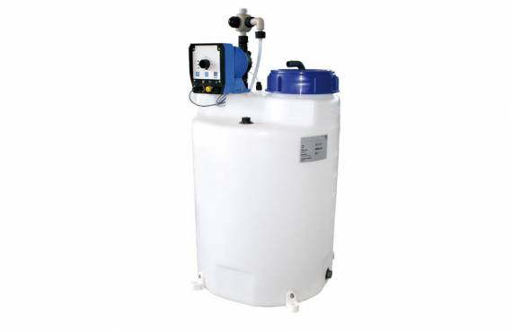




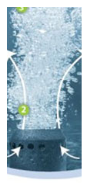
ROOTS TYPICAL LAYOUT
Plant
Bioenzyme preparation and activation
BIOVESSEL 1
BIOVESSEL 2
Biomedia + Active bacteria colony
Biomedia + Active bacteria colony
Absorbent
Raw wastewater
Settling
Air diffuser
Air diffuser
River
Air blower
BLUE E TECH SDN.BHD

Slide 6
ROOTS COMPONENTS
ROOTS consists of the following major components
SB2L microbial enzyme system
Bio-vessel consisting of
a. Biomedia
b. Air diffusers
SB2L microbial enzyme breaks down large organic molecules to smaller size for easy digestion by microbes
Biomedia provides nesting area for bacteria colony to propagate whereas air diffusers supply the air for the bacteria colony
BLUE E TECH SDN.BHD

Slide 7





HOW SB2L MICROBIAL ENZYME WORKS FOR DIFFERENT TYPES OF WASTE
Decomposing Refractory Large Molecular Organic Matter
Hydrolysis
Small Molecular Stage
FOG
Lipase
Bio-Based Enzymes
Glycerin
+
Fatty Acid
Decomposition
Starch
Amylase
Bio-Based Enzymes
Glucose
Activated Sludge
(Microbe)
Activation
Protein
Protease
Bio-Based Enzymes
Amino Acid
BLUE E TECH SDN.BHD

Slide 8
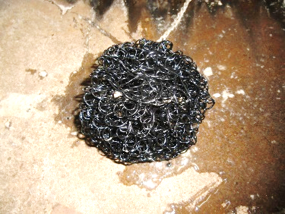
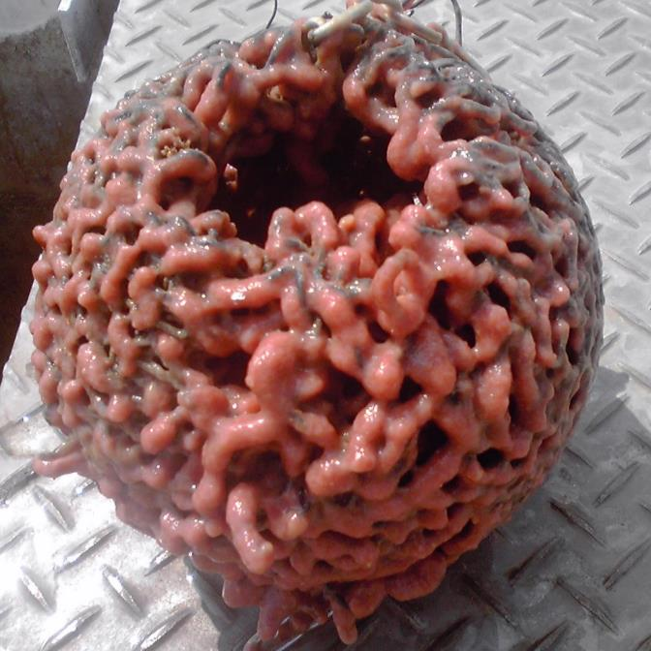
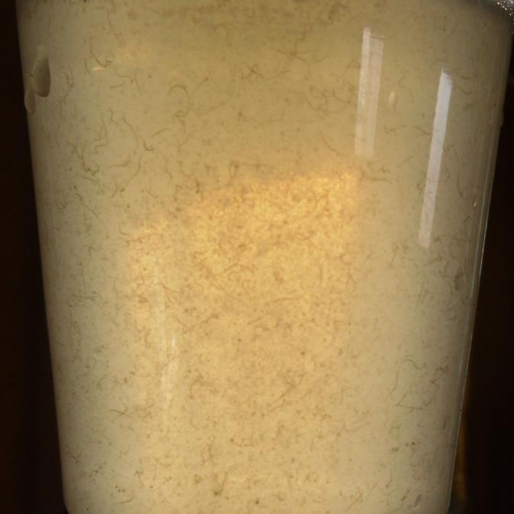
BIOSLIME GROWTH PROFILE ON ROOTS BIOMEDIA
The biomedia allows the growth of aerobic and anaerobic bacteria thus it’s a very efficient system
Ball shaped biomedia at the beginning of process
CO₂
N₂
→Air
O₂
Reaction Product
Organic Matter
Ball shaped biomedia after bacteria colony developed
Detached
Sludge
→Water Layer
H₂O
NH₄⁺
→Aerobic Biofilm
N₂
N₂
NO₂⁻
NO₃⁻
→Anaerobic Biofilm
Microbial worm in wastewater
→Bio-media
BLUE E TECH SDN.BHD

Slide 9
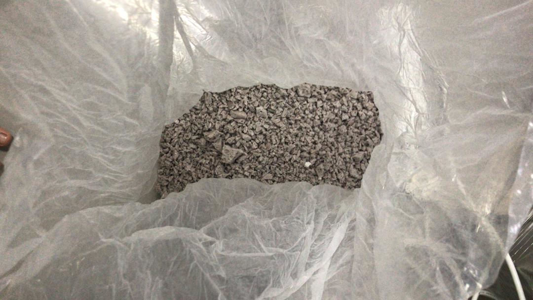
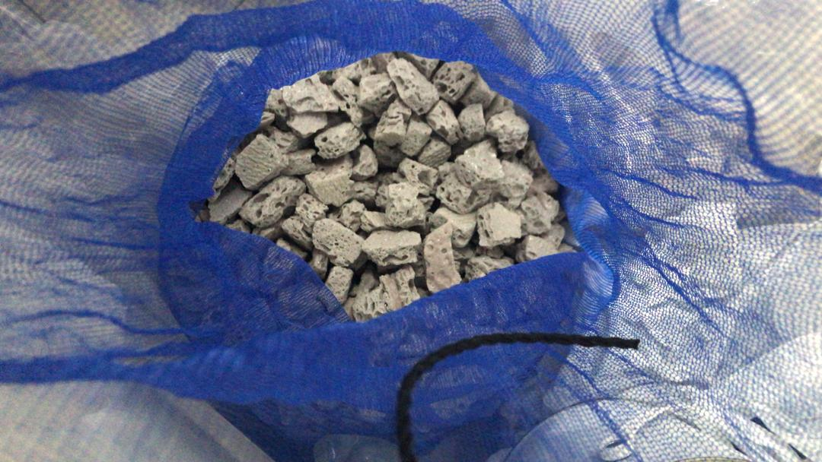
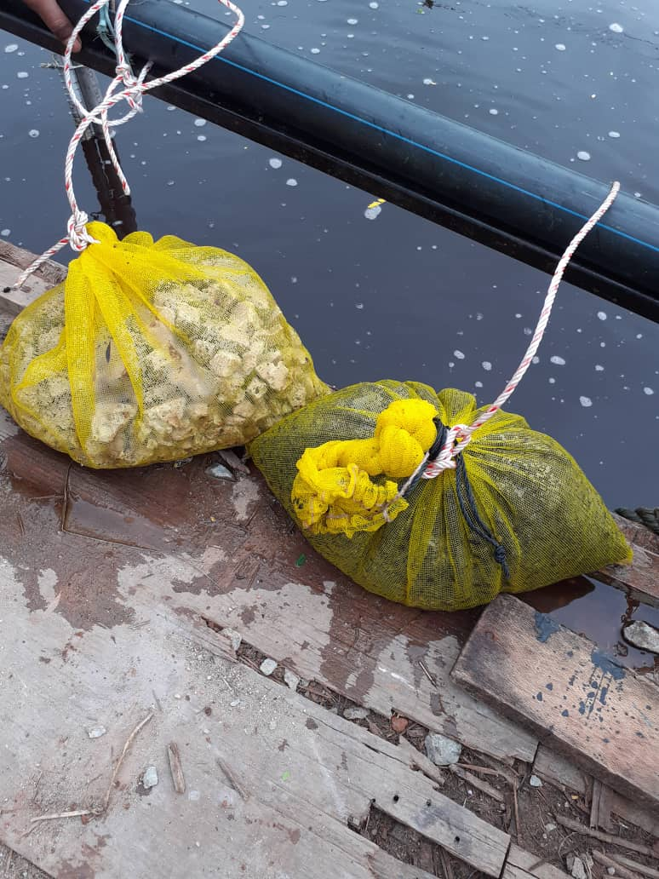
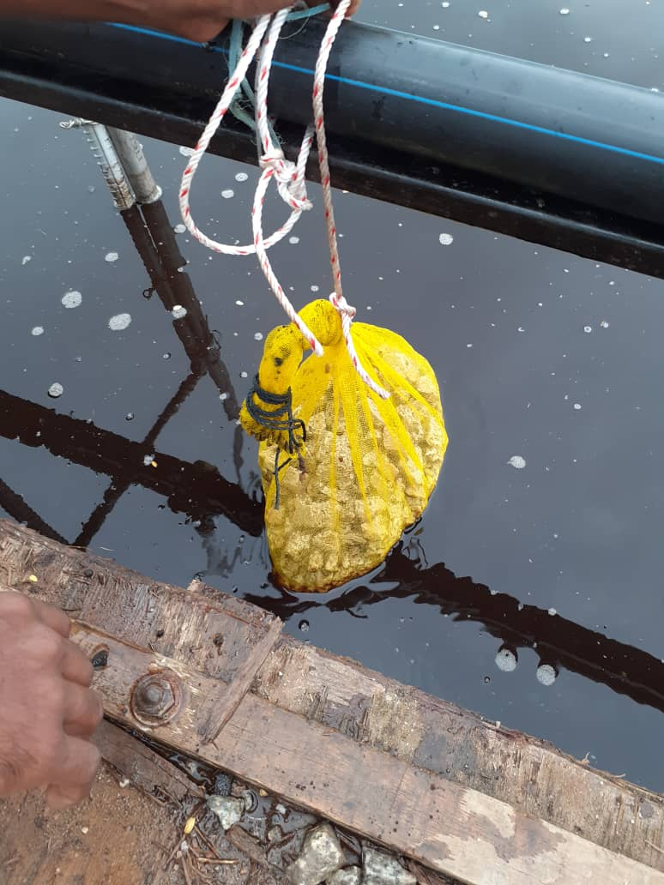
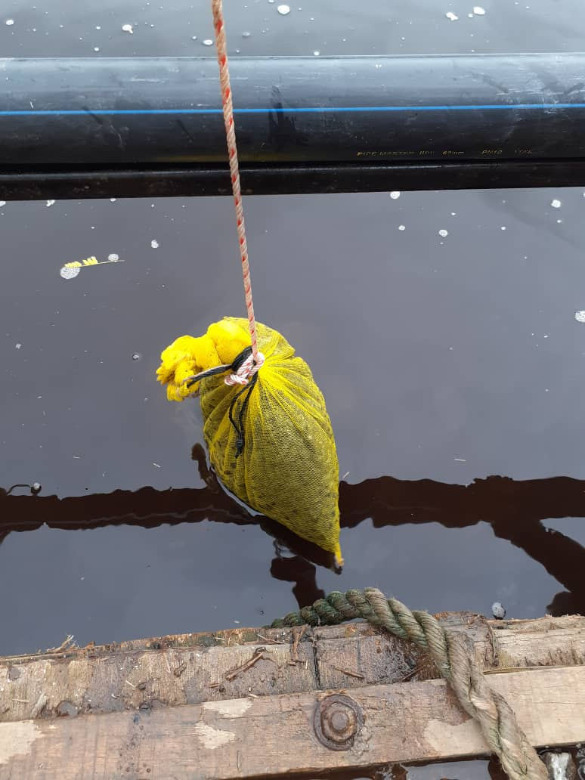
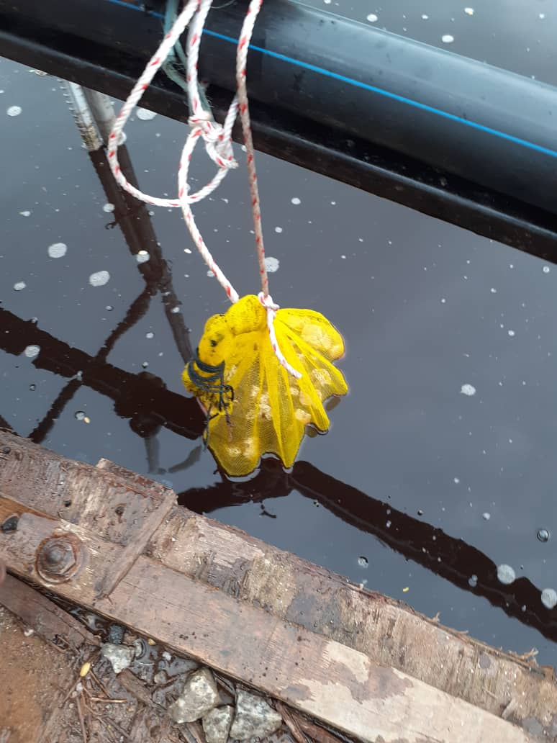
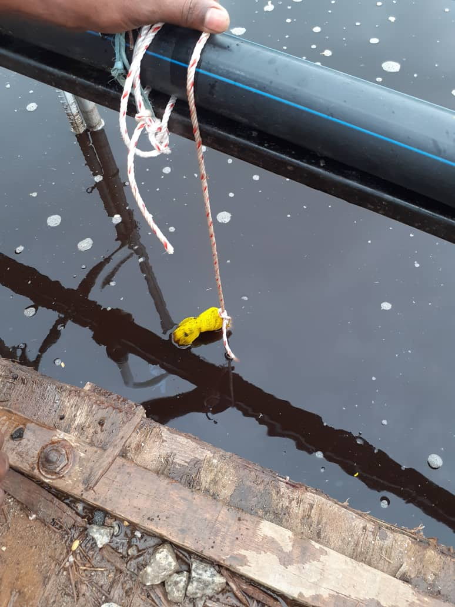
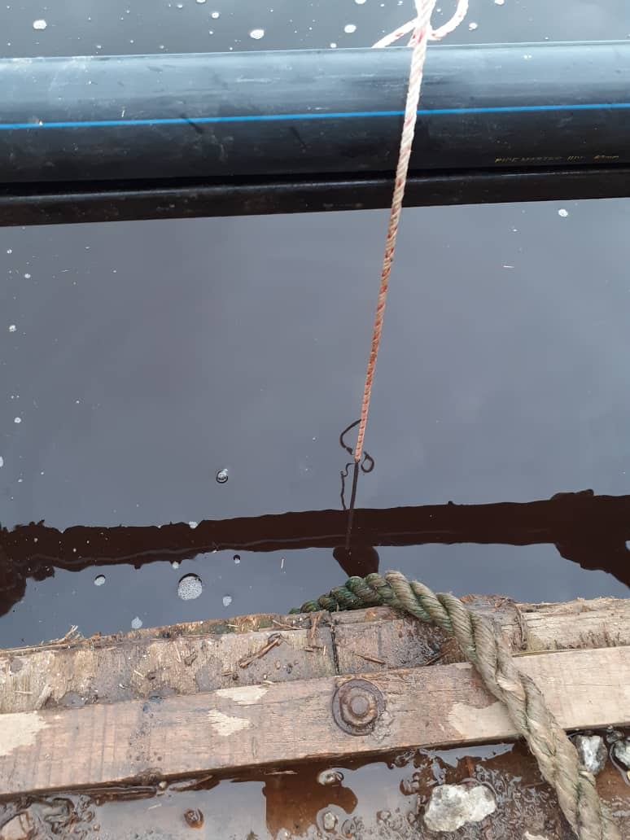
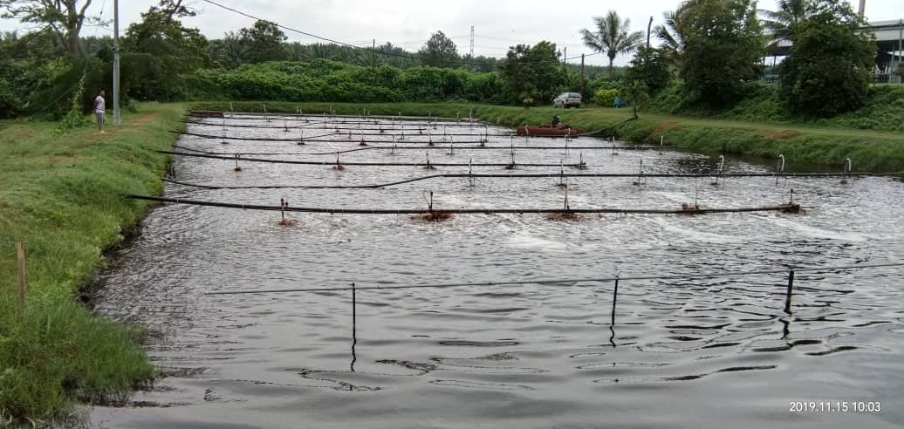
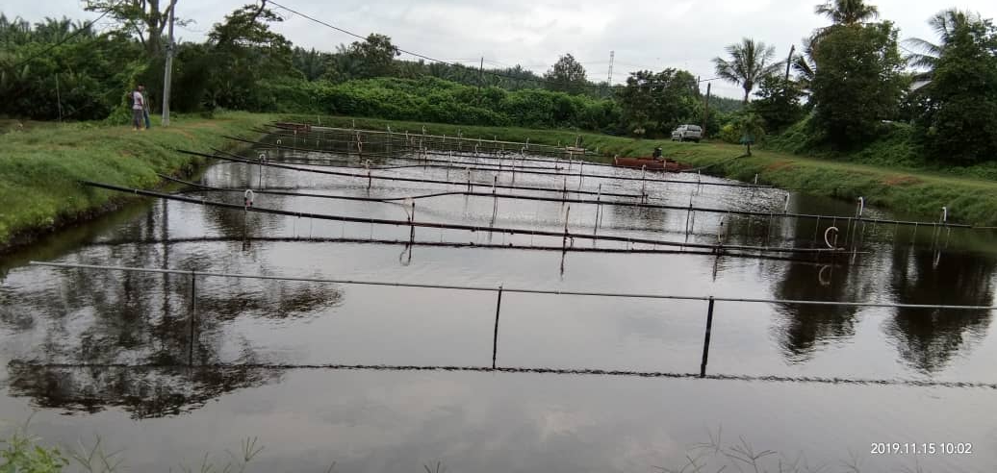
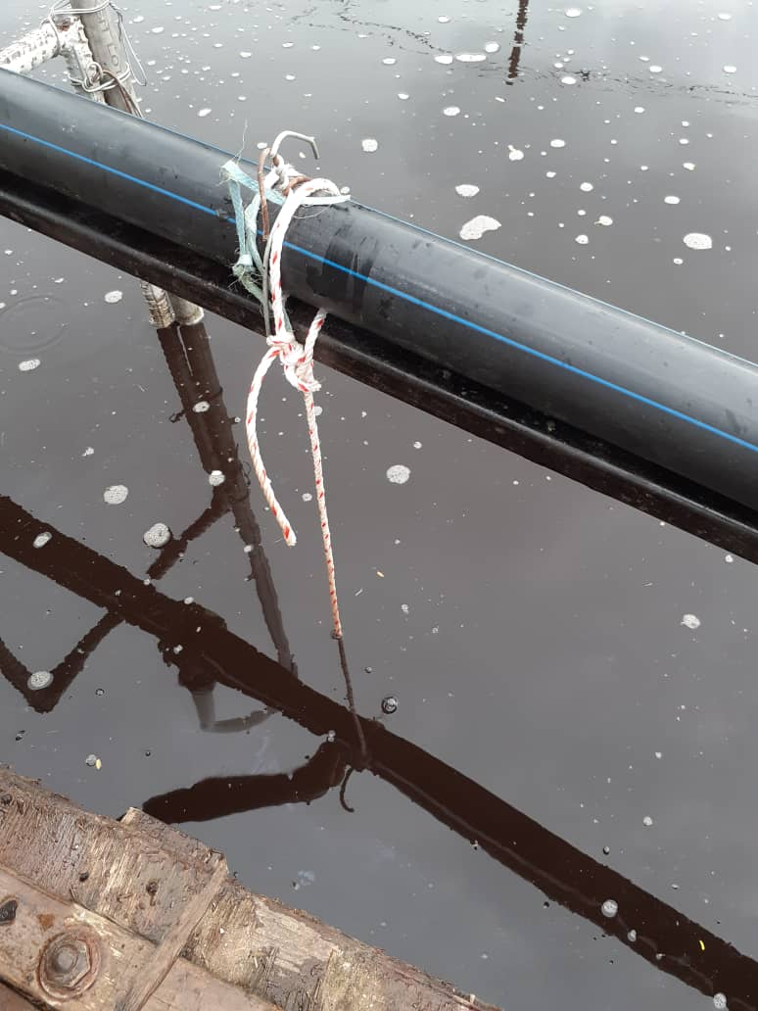
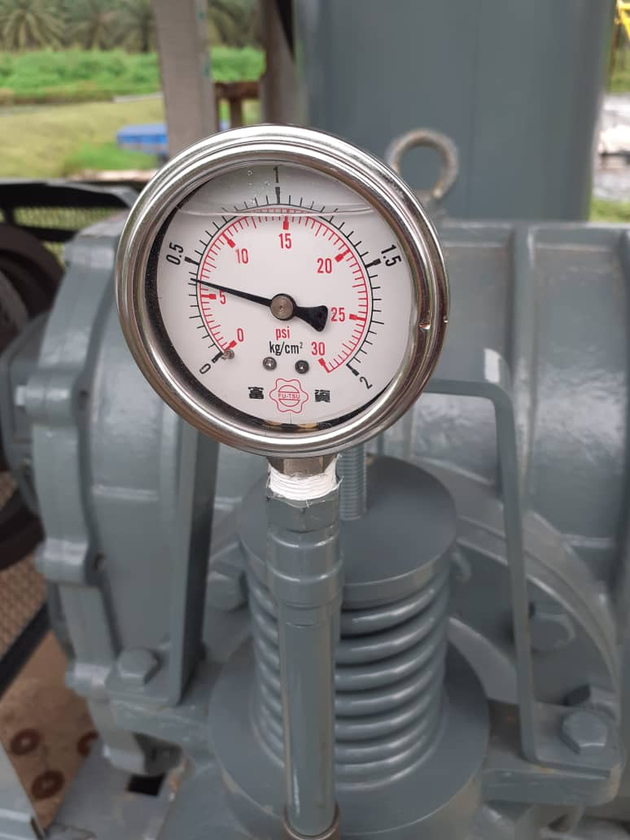
PROJECT PHOTOS OF INSTALLED ROOTS BIOMEDIA
BLUE E TECH SDN.BHD

Slide 10
DOE NEW EFFLUENT DISCHARGE STANDARD
From year 2020 onward, DOE Johor has imposed a more stringent requirement for Palm oil Mill wastewater discharge parameters to improve river water quality. The table below shows the new and previous discharge limits. To meet this new requirement, Blue E Tech was engaged to upgrade their current system using ROOTS to meet the new discharge standard.
Wastewater parameter | Previous POME Effluent Discharge Standard | New POME discharge standard to comply
BOD | 100 | 20
SS (Suspended solids) | 400 | 50
AN (Ammoniacal nitrogen) | 150 | 20
TN (Total nitrogen) | 200 | 100
Oil & Grease | 50 | 20
pH | 5-9 | 5-9
Temperature | <45 ⁰C | <45 ⁰C
BLUE E TECH SDN.BHD

